Slide 1




Car Warehouse System
System for both the customers and administrators
Student Name:
Student ID:
Supervisor's Name:
Module: SEN4000
Notes:
Welcome to everyone so now I will be presenting my final year project presentation, which is the Car Warehouse System. This is an online system, which is made in Python that manages car inventories for both the customers and administrators.

Slide 2
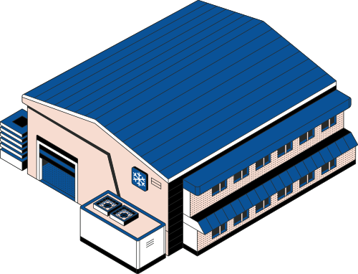
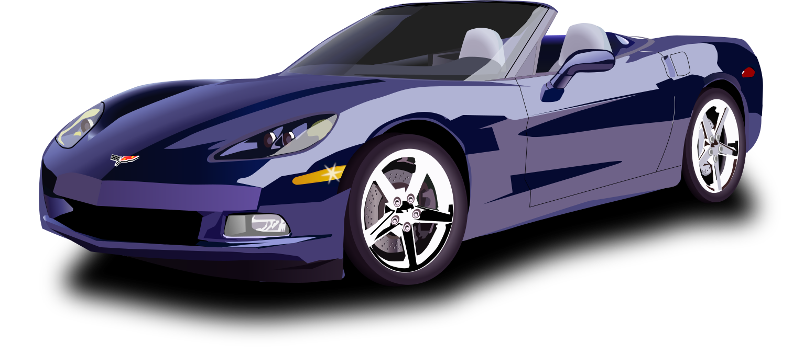
Introduction
Overview: The Car Warehouse System is a console based system application, that is developed in Python that aims to make the work of all the customers and also administrators easy for managing car inventories (Cubas-Guevara et al., 2023).
Features:
This system provides all the essential features to view, search, sort, and update the data of cars in an easy-to-use interface which is menu-driven.
The system has been designed with simplicity, functionality, and cost efficiency.
It uses CSV files for data storage, making it light and applicable to petty businesses or academic demonstration.
Notes:
This Car Warehouse System allows the all its users to view, search, and also sort the car listings, while for a user administrator can also manage the inventory. The language used in this system is Python and in this project the basic file handling with a simple functional terminal interface is used.

Slide 3


Problem Description
Problem
The small automotive dealers who do not have expensive and sophisticated software tools for managing the car inventory mostly rely on manual processes or, worse, basic tracking of their vehicle inventory in spreadsheets (Ramos et al., 2020). This results in either inconsistencies in data regarding availability or poorly inefficient service to customers.
How it solves the problem
This project aims at developing an inexpensive and light solution for organized and efficient vehicle inventory management. This system promises to provide essential features through a simple command-line interface without needing extensive installations or new hardware.
Notes:
The most small-scale dealers still maintain all records in a manual fashion or with by taking help of spreadsheets, thus it creates the chances for errors and inefficiency. This project aims to fulfil the need for a cost-effective digital tool which can assist for managing and tracking the availability of car.

Slide 4

Objective Rationale
The first introduction is focused on a vehicle inventory system, which includes both user and admin interface functionalities (Ghiani, Laporte and Musmanno, 2022).
The system for the user will deal with vehicle search and browse based on price, type, size, or brand; for the admin, it will entail creating, editing, or updating vehicle data.
This ensures that the functionalities which the system will contain are available to a user without requiring a high degree of technical expertise, and, in the process, the system emerges as a computer-based system capable of operating in the real world.
Notes:
The primary objective was to provide user-friendly options for searching, which will help the admin Undo within shops.

Slide 5
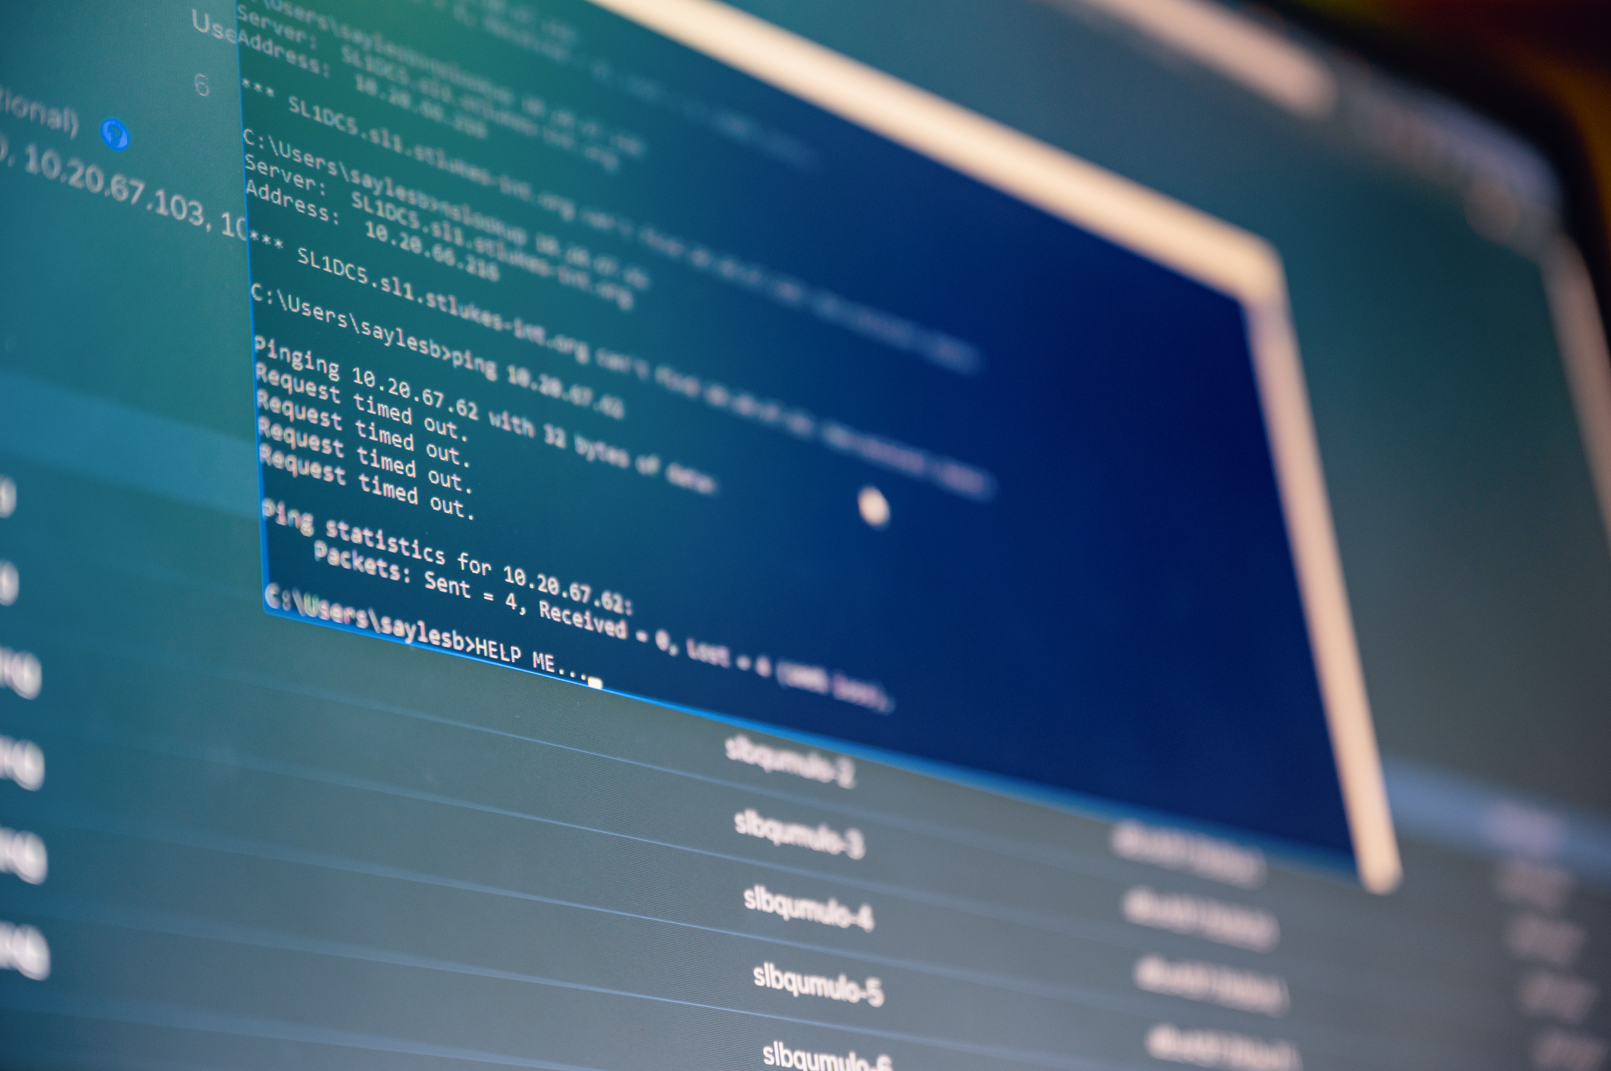


Technologies Used
This Python project has been developed in Python for its readability and strong community support.
CVS files are used for storing and retrieving car data. This is useful for small data, prototype use (Mahmud et al., 2019).
Interaction with the program is done by a direct terminal; it has no dependency on any GUI framework or external library.
The program is modular; it consists of functions that load, display, and update inventory records. This makes the system scalable and easy to maintain.
Notes:
Python was selected for its simplicity and readability. Data is stored in CSV files, which together make the project platform-independent and ready for deployment without taking help of any other database.

Slide 6
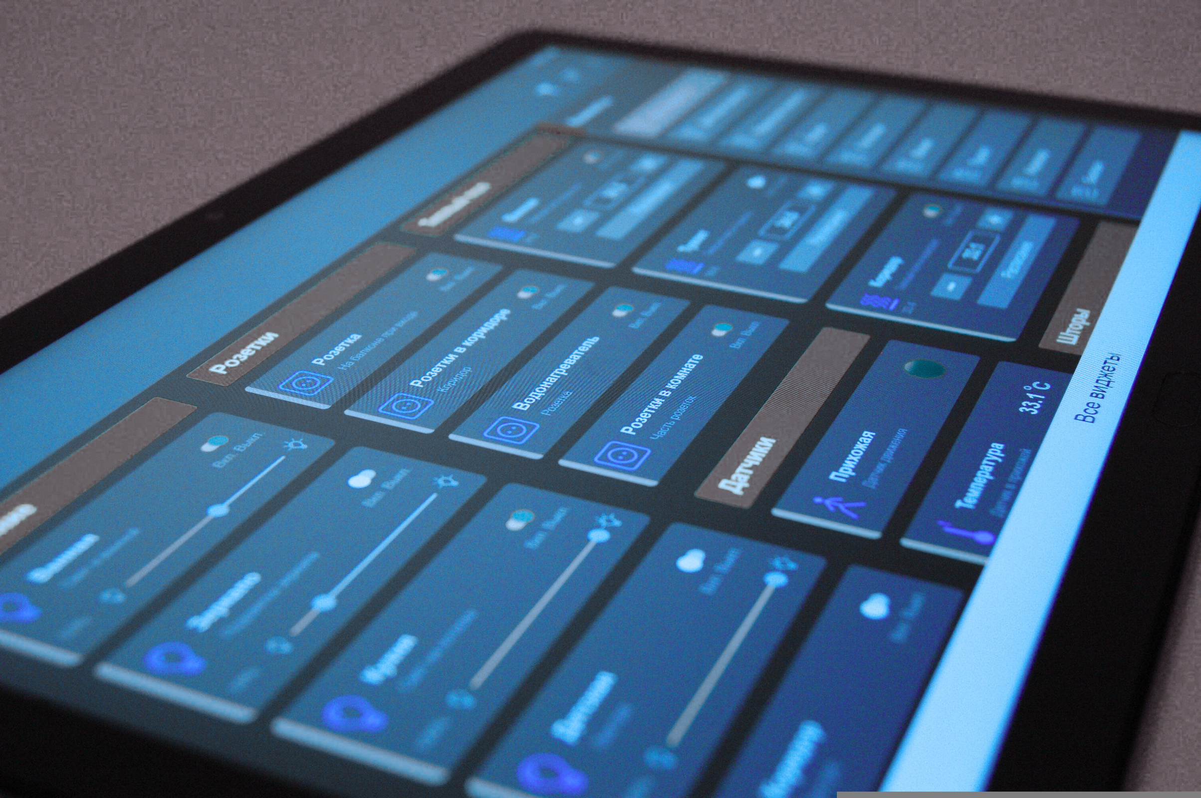

System Functionality - User Mode
User mode is created for clients and other general visitors wishing to see the inventories available (Roggeveen and Sethuraman, 2020).
Users can view all vehicles currently listed, search within their budgets, refine the car selection by the manufacturing year, or look for specific brands.
In addition, users can sort listings according to price or year in ascending or descending order.
The essence of these features has been mirroring a smooth browsing experience similar to a digital catalogue, where the users can thus make their decisions more efficiently.
Notes:
This system has the user mode, in which it allows customers to explore all the available cars by applying different types of filters. It also allows the sort preferences. This feature makes the system easy to navigate to the right option easily.

Slide 7
System Functionality - Admin Mode
In this system the admin mode is very necessary for managing inventory.
Admins can view the entire database of cars, add new listings with all required information, and edit existing databases (Aji et al., 2020).
Updating involves anything from pricing, color change of the car, and modifying the availability status (i.e. available or sold).
This separation of roles ensures that important functions are restricted to authorized personnel and keeps data integrity.
Admin mode has input validation to protect against unintentional corruption.
Notes:
Admins have dedicated controls to manage car data efficiently. The update feature allows them to modify key fields without deleting full records or rewriting them.

Slide 8

Core Programming Principles & Layout
The program employs the modular style, whereby a module or each function takes responsibility or is aware of its assignment.
Role selection is provided on the application's primary screen, which feeds user traffic into their respective requirement-specific menu items.
Functions like load_data() and save_data() are used to control actions performed on a closed CSV file when handling persistent vehicle data (Kumar and Hooda, 2023).
The code is presented to promote reusability and enhance coding clarity; no repetition occurs when it comes to matters of reuse.
The menus are engineered to be modular, given loops that sit around the menu above admin and user interaction-while-loops- to gracelessly control menu input.
Notes:
Design: Modular state is emphasized while designing the individual functions to handle data load, display, and updates. Run independently with whatever admin and user aspects share the core logic to make code repeat.

Slide 9



Testing & Output
Testing
Data has been manually tested within the various input combinations as well as with all the edge cases (Srivastava, Kumar and Singh, 2021).
The test case objectives were validating operations like adding new vehicles, updating, searching with wrong inputs, and sorting lists.
Output
Taken terminal screenshots of the output withhold sorting displays and updated details as expected.
Validation rules were put into place to avoid breakages under interface crashes later on; type mismatch and out-of-range values were outlawed for smooth errorless navigation through the site.
Notes:
The system was human-tested with a range of varying scenarios that extend to edge cases like invalid input. Terminal outputs are hoped to show that the system outperformed in search, sort, and update.

Slide 10

Conclusion
Critical Analysis: The Car Warehouse System is able to achieve the initial goals of being an operational and user-friendly tool for car listing management purposes. This is a simple and easy solution for a small dealership or an individual who has an interest in inventory management systems.
Challenges Faced: The main challenge was to ensure the data handling and also validation without using GUI, because it requires careful error-checking in terminal-based input.
Future Scope: Some future improvements can be the application of a graphical user interface using Tkinter or Flask; connection to an SQL database for better capacity scaling; and the introduction of login-based authentication for better security. All of these will improve the robustness of the system and suit its commercialization as well.
Notes:
So, the end result is that the system does perform its job quite effectively. The next thing I want to do is to enhance the user experience by adding a nice graphical interface, a proper database, and login functionalities for better security in the future.

Slide 11

References
Aji, P., Renata, D.A., Larasati, A. and Riza (2020). Development of Electric Vehicle Charging Station Management System in Urban Areas. [online] IEEE Xplore. doi: https://doi.org/10.1109/ICT-PEP50916.2020.9249838.
Cubas-Guevara, A.A., Alvarado-Ojeda, J.A., Gomez-Briones, N.M., Gonzales-Candiotti, R.V., Escobar-Baquerizo, S., Huamanchahua, D. and Valcarcel-Castillo, H. (2023). Automotive Vehicle Inventory and Sales Management System Employing Python. 2023 IEEE Colombian Caribbean Conference (C3), [online] pp.1–6. doi: https://doi.org/10.1109/c358072.2023.10436291.
Ghiani, G., Laporte, G. and Musmanno, R. (2022). Introduction to Logistics Systems Management With Microsoft Excel and Python Examples. [online] Google.co.in. Available at: https://www.google.co.in/books/edition/Introduction_to_Logistics_Systems_Manage/pzeVEAAAQBAJ?hl=en&gbpv=0 [Accessed 3 May 2025].
Kumar, S. and Hooda, (2023). Customer-Vehicle Management System. Juit.ac.in. [online] doi: http://ir.juit.ac.in:8080/jspui/jspui/handle/123456789/9867.
Mahmud, S.M.H., Hossin, Md.A., Hasan, Md.R., Jahan, H., Noori, S.R.H. and Ahmed, Md.R. (2019). Publishing CSV Data as Linked Data on the Web. Proceedings of ICETIT 2019, pp.805–817. doi: https://doi.org/10.1007/978-3-030-30577-2_72.
Ramos, E., Pettit, T., Flanigan, M., Romero, L. and Huayta, K. (2020). Inventory Management Model Based on Lean Supply Chain to Increase the Service Level in a Distributor of Automotive Sector. Int. J Sup. Chain. Mgt, [online] 9(2). Available at: https://core.ac.uk/download/pdf/322571503.pdf.
Roggeveen, A.L. and Sethuraman, R. (2020). Customer-Interfacing Retail Technologies in 2020 & Beyond: An Integrative Framework and Research Directions. Journal of Retailing, [online] 96(3), pp.299–309. doi: https://doi.org/10.1016/j.jretai.2020.08.001.
Srivastava, N., Kumar, U. and Singh, P. (2021). Software and Performance Testing Tools. Journal of Informatics Electrical and Electronics Engineering (JIEEE), 2(1), pp.1–12. doi: https://doi.org/10.54060/jieee/002.01.001.

Slide 12


